Slide 1

based measuring device
MARIA STOYANOVA AND DESISLAVA BALKANDZHIEVA

Slide 2
What is it?
*It measures 3 physics dimensions - electrical currency, voltage and resistance.
*It measures 3 physics dimensions - electrical currency, voltage and resistance.

Slide 3
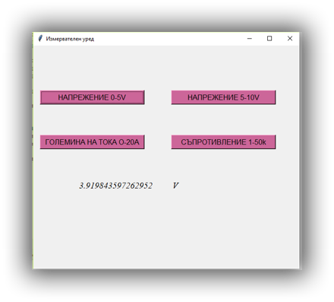
INTERFACE

Slide 4
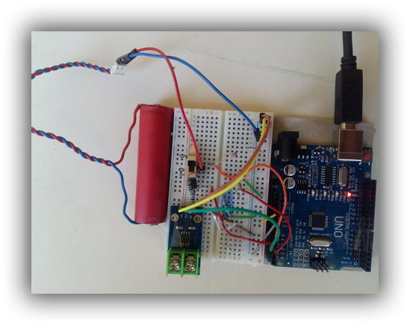
Hardware

Slide 5
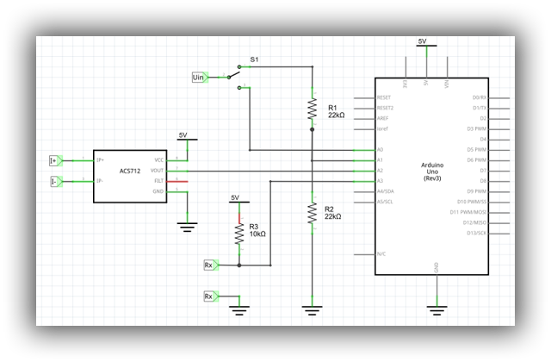
Electrical circuit

Slide 6
Future plans
In future, we'd like to improve /advance our project by adding graphics in real time and the possibility of saving the results

